Slide 1
School Security Measures:
Roles of School Resource Officers
John Rosiak, M.A.
Prevention Partnerships, Rosiak Associates, LLC
john@rosiakassociates.com
October 2018
Washington, DC

Slide 2
What is a School Resource Officer (SRO)?
“A career law enforcement officer with sworn authority who is deployed by an employing police department or agency in a community-oriented policing assignment to work in collaboration with one or more schools.”
Source: National Association of School Resource Officers (NASRO)

Slide 3
The goal of SRO programs is to:
• “Provide safe learning environments in our nation’s schools
• Provide valuable resources to school staff
• Foster a positive relationship with our nation’s youth, and
• Develop strategies to resolve problems affecting our youth with the goal of protecting every child so they can reach their fullest potential.”
Source: NASRO

Slide 4
Defining School-based Law Enforcement:
“SBLE” is a broad term that encompasses law enforcement officers working for the safety of students. The term is evolving in the field of policing schools.
SBLE: Term used by NASRO and the COPS Office (U.S. DOJ).
Changing landscape. Some use the term broadly to refer to the many different safety personnel who work in the area of school safety.

Slide 5
Context of SBLE:
• Part of school safety mission.
• Partner with others.
• Should be part of positive school climate.
• Diversion.

Slide 6
Variety of SBLE:
• SROs.
• School District Police Departments.
• School security.

Slide 7
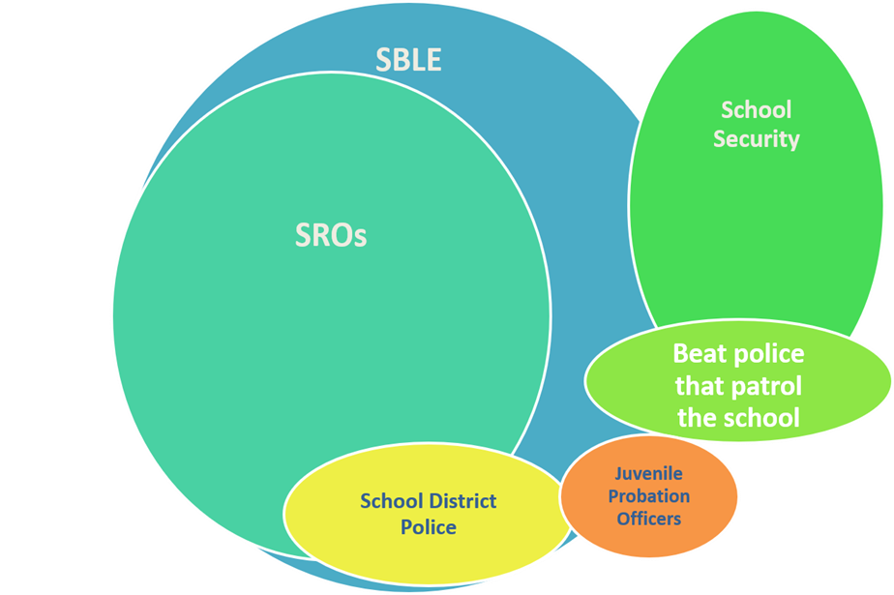

Slide 8
Quick facts: SROs and numbers:
• Estimated 20,000 SROs.
• About 40% of schools have SROs.
• Most are employed by local police/sheriff’s departments.
Notes:
42% of public schools have SROs: Indicators of School Crime and Safety: 2017 (NCES 2018-036/NCJ 251413). National Center for Education Statistics, U.S. Department of Education, and Bureau of Justice Statistics, Office of Justice Programs, U.S. Department of Justice. Washington, DC.
In 2007, an estimated 38% of local police departments, employing 76% of all officers, had fulltime sworn personnel assigned as SROs.5 Local Police Departments, 2007
December 2010 NCJ

Slide 9
History of School-based Law Enforcement
1950’s: Roots of police officers in schools. Officer Friendly, community relations.
1960/70’s: Steady expansion.
1980’s: Growth related to drug prevention.
1990’s: Expansion through COPS Office.
2000’s: Continued expansion, critique.
2010’s: Increase related to shootings.
Today: Proliferation after Parkland massacre.

Slide 10
Roles: traditional triad:
• Educator.
• Informal counselor/mentor.
• Law enforcer.
• Other roles: Resource: roles like a parent or social worker.

Slide 11

SRO Triad Concept
Teacher (LRE)
Counselor/Mentor
Law Enforcement Officer
Notes:
Informal Counselor/Mentor. Remind participants that when they are with a student one-on-one to be sure they are visible to other adults.
Work within the context of knowledge, training, and the expertise of a law enforcement officer
Work closely with the school’s counselors, social workers, psychologists, nurses, teachers, administrators, etc.
Provide information on community services and the law to students, parents, and staff
Program coordinator

Slide 12
Roles differ/roles matter:
• Needs/desires of local community.
• Public safety/enforcer—punitive.
• Educator/counselor--decrease in negative behavior.

Slide 13
Challenging issues for SBLE:
• School exclusion:
    Suspension and expulsion.
    Arrest.
• Disproportionate contact.
• Resource question:
    Cops or counselors?

Slide 14
Roles for diversion:
• Define roles.
• Select.
• Train.
• Guide by policy.
• Engage with community.
• Measurement.

Slide 15
Research:
Studies old/conflicting. Varied interpretations.
Standards uneven. Some poorly done. Lack comparison groups.
Not distinguish school security personnel from full-time, sworn SROs; or differences in roles, selection, training, etc.
Newer research.
Notes:
CSG, CRS, WestEd, etc. surveys.

